Slide 1
Python Project
Daniel Pinchasov

Slide 2
The Problem
What are we trying to predict ?
In this project we are researching the data and trying to predict which customer will churn the company
What data is available for that (input) ?
We used existing data where we know if the customer was churn or not ,with another feature that can explain us the reason of churn
What can be the motivation and applications for solving the problem?
Using advanced tools like ML in addition to understanding the behavior of customers who churn

Slide 3
Data description
How many examples are in dataset ? (train/test)
We have a group of 7,042 customers where 80% (5,633 customers) constituted group train and 20% (1,408 customers) constituted test
How many features are in dataset ?
We used 5 features that we choose from the df : contract , internet service , paperless billing, payment method , seniority.
Our goal was finding the features that have high correlation with our label data and then put them in ML Algorithms
What is the distribution of labels ?
1,869 of customers (27%) was churn,
5,174 of customers (73%) wasn’t churn
Are there any missing values?
We had 11 missing values (0.156%) in “total charges” column

Slide 4
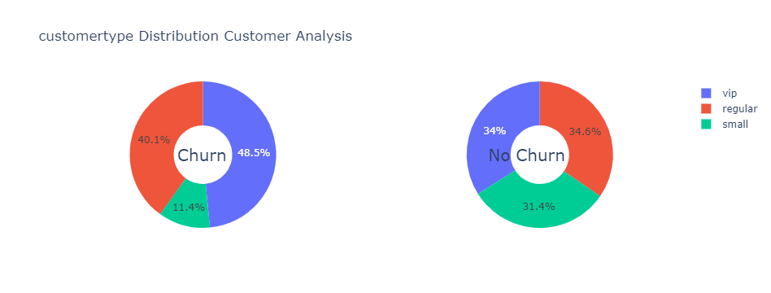
Data description – graphs
This is the distribution of our new feature on our label data.
Based on that we can assume that small customers have a positive tendency to stay in our company “no churn”.

Slide 5
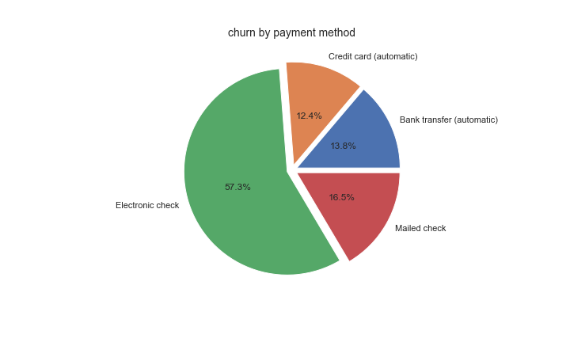
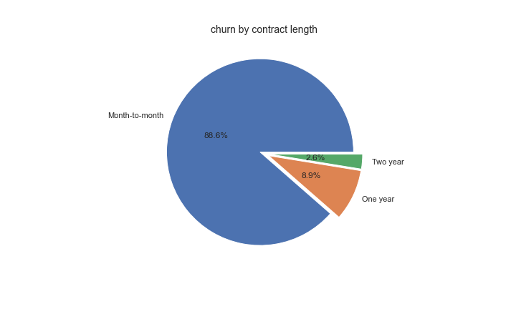
Data description – graphs
We decided to split the data and focus on the customer “churn” which constitutes 27% from all the customers data.
Conclusions:
1. The company need to sign their customers to long tern contract.
2. Customers that paid on check, especially electronic check Tend to leave the company more then customers that paid automatic method.

Slide 6
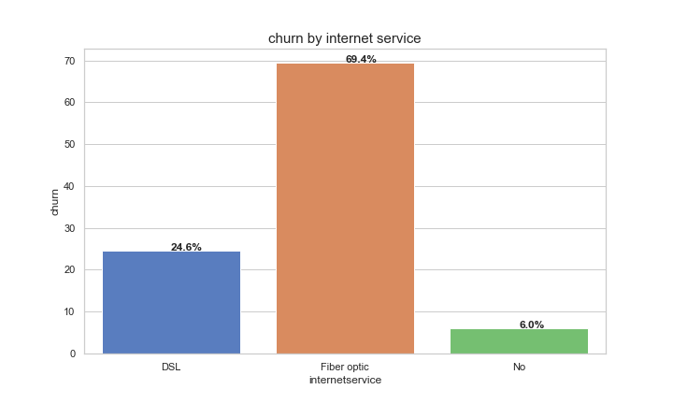
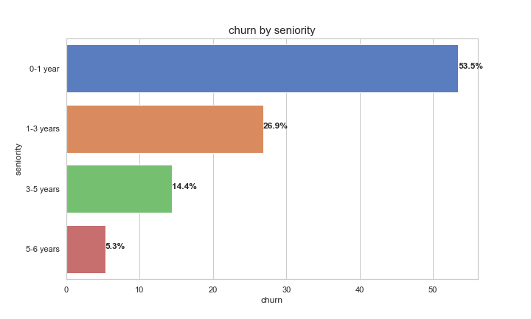
Data description – graphs
We see here that if the customers don't have internet services the chances to “no churn” high.
Also, we can assume that customers who have 'fiber optic' are at high risk to churn.
Here we see that The longer the customer stays in the company, the lower the chance that he will leave in the future.
Another finding we can see from the plot, is that most of the client's churn in their first year

Slide 7
Data Engineering
Feature who had no big influence : gender , senior citizen , multiple lines , device protection , streaming movies , phone service..
Feature we used to create new Feature and remove them : tenure and monthly charges
Did you remove any feature ?
Did you add any feature ?
We added the “seniority” feature that is based on tenure and create seniority groups overs the years.
We also grouped “monthly charges” column and created feature “customer type”, which is based on his charges per month.
What did you do with missing values ?
Because there are no many missing values, only 11 values (0.156%) that did not affect the data we change them to zero

Slide 8
ML Algorithms
Knn Accuracy: 0.794
Decision Tree Accuracy: 0.792
Random Forest Accuracy: 0.792
Benchmark Accuracy: 0.738
As we can see the prediction chances in our various models were 6% higher than our benchmark, not so great but still good.

Slide 9
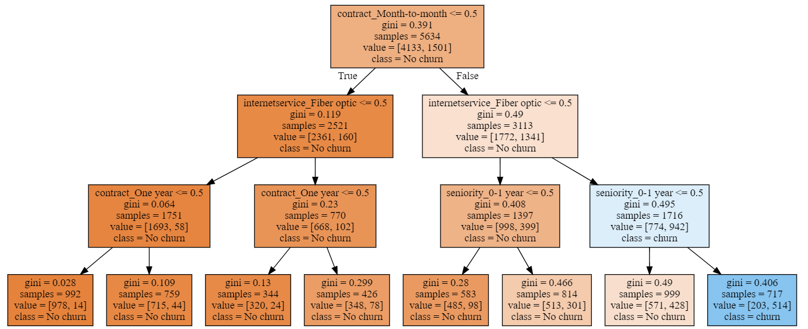
Decision tree
Points and explanations regarding the decision tree:
The blue colors in the wood indicate the variables that affect the determination of the model whether a customer will churn.
The orange color indicates that the customer will stay (No churn) according to the model.
As we can see in the tree, its root feature that it chose to use is a "monthly contract" for the initial segmentation.

Slide 10
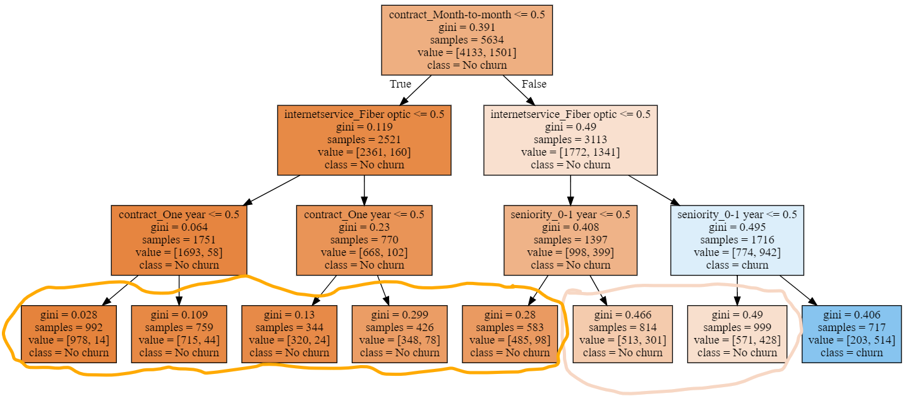
Decision tree
After that, the decision tree has decided on a division according to the internet service.
He decided that a customer who had a "fiber optic" Internet service and his seniority is between 0 and 1 years would Churn. And in the other distribution the customers “No churn”.
In the leaves of the tree can be seen on the left (5 leaves) the dominant class is “No churn”, and in the 2 other leaves that the division between those who “churn” and “not churn” very close, and not absolute as in the rest of the leaves.

Slide 11
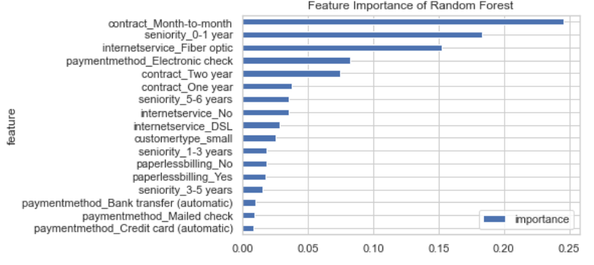
Random Forest
As we can see the Random Forest feature importance are almost the same as the feature importance we have seen before in the correlation

